Slide 1
Being On Fire without Burning Out
Dr Grant Bickerton
August, 2015

Slide 2
Session Goals
What are the processes that lead to experiences of Burnout and Engagement at work?
Discuss the mix of demands you experience in your work context.
Consider the work characteristics and personal attributes that may act as motivational resources.
Identify behaviours that manage felt stress from demands, promote increased engagement at work, and prevent or intervene where burnout emerges.

Slide 3
The Job Demands-Resources Model
Health impairment process
Burnout
- Exhaustion - Cynicism - Low personal accomplishment
Ministry-Job Demands
Negative work Performance Indicators
Motivational process
Ministry-Job Resources
Engagement
Vigour - Dedication - Absorption
Positive work Performance Indicators
Personal Resources

Slide 4
The Job Demands-Resources Model
Health impairment process
Burnout
- Exhaustion - Cynicism - Low personal accomplishment
Ministry-Job Demands
Negative work Performance Indicators
Motivational process
Ministry-Job Resources
Engagement
Vigour - Dedication - Absorption
Positive work Performance Indicators
Personal Resources

Slide 5
The Job Demands-Resources Model
Health impairment process
Burnout
- Exhaustion - Cynicism - Low personal accomplishment
Ministry-Job Demands
Negative work Performance Indicators
Motivational process
Ministry-Job Resources
Engagement
Vigour - Dedication - Absorption
Positive work Performance Indicators
Personal Resources
Never be lacking in zeal, but keeping your spiritual fervour serving the Lord
(Rm. 12:11)

Slide 6
Job Demands and the Helath Impairment Process
Health impairment process
Burnout
Negative work Performance Indicators
Ministry-Job Demands
Emotional Exhaustion
Depersonalisation / Cynicism
Lack of personal accomplishment
Depression
Anxiety
Low personal initiative
Intention to leave
Work load and type
Control and Ambiguity
Expectations
Interpersonal conflicts
Values/vision mismatch with team

Slide 7
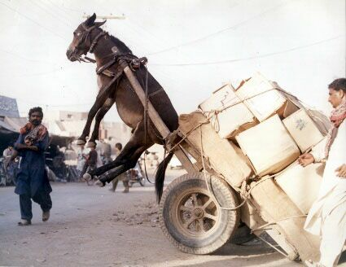
Workload and Time Demands
Workload without recovery
Work-type mismatch
Always more to be done
Not enough time to do all that needs to be done

Slide 8
Demands of Work-Home interference or blurred family boundaries
Ambiguous separation between professional and private lives
Can be overly visible – mixing with those we serve socially as well as pastorally thereby playing the professional role even during free time

Slide 9
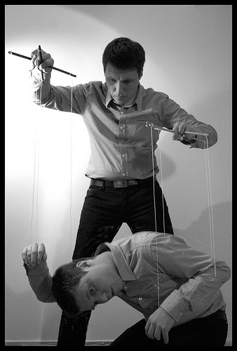
Control, Role conflict and Ambiguity
Where individuals have insufficient control over the resources needed to do their work, or have insufficient authority to pursue the work in what they believe is the most effective manner

Slide 10
Demands of High Expectations
Expectations of personal perfection – Sole (as well as soul) Saviour!
Expectations of marital and family perfection
Expectations coming from:
Self
Congregation
“God”
Results in a lack of self-care and limit setting

Slide 11
The variety of tasks and skill-set required
Educator - training, instructing and leading study groups
Social reformer – engaging injustice and inequality
Evangelist - converting others to faith
Organiser and visionary - organising and supervising the work of others
Pastor – visiting and counselling
Preacher - delivering sermons, expounding the Word
Scholar - reading, studying, teaching and writing

Slide 12
Interpersonal Conflict and values mismatches
Conflicts with and between team members
Conflicts in values and emphases in ministry

Slide 13
Isolation
Constriction of relationships to ministry/ always being in the ministry role.

Slide 14
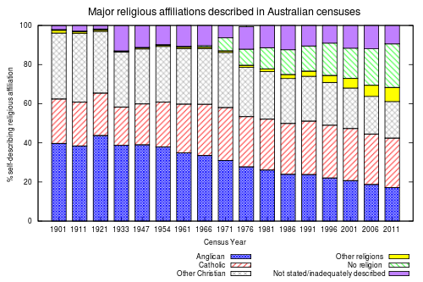
Changes in Society
Changes in society meaning that the role that one has been trained for may not fit the requirements, desires and needs of the community with and in which one seeks to minister.

Slide 15
Financial Demands and effort-reward imbalance
The results of various studies have shown that insufficient reward (whether financial, institutional, or social) increases people's vulnerability to burnout

Slide 16
Fairness
Decisions at work are perceived as being unfair and inequitable

Slide 17
What job demands do you face?
What are some of the job demands you consider significant in your role?
Which job demands would you consider challenges?
Which job demands would you consider hindrances?
What are some of the job demands you consider significant in your role?
Which job demands would you consider challenges?
Which job demands would you consider hindrances?
Burnout
- Exhaustion - Cynicism - Low personal accomplishment
0
Ministry-Job Demands
Negative work Performance Indicators
What are some of the ministry-job demands you consider significant in your role?
Which ministry- job demands would you consider challenges?
Which ministry-job demands would you consider hindrances?

Slide 18
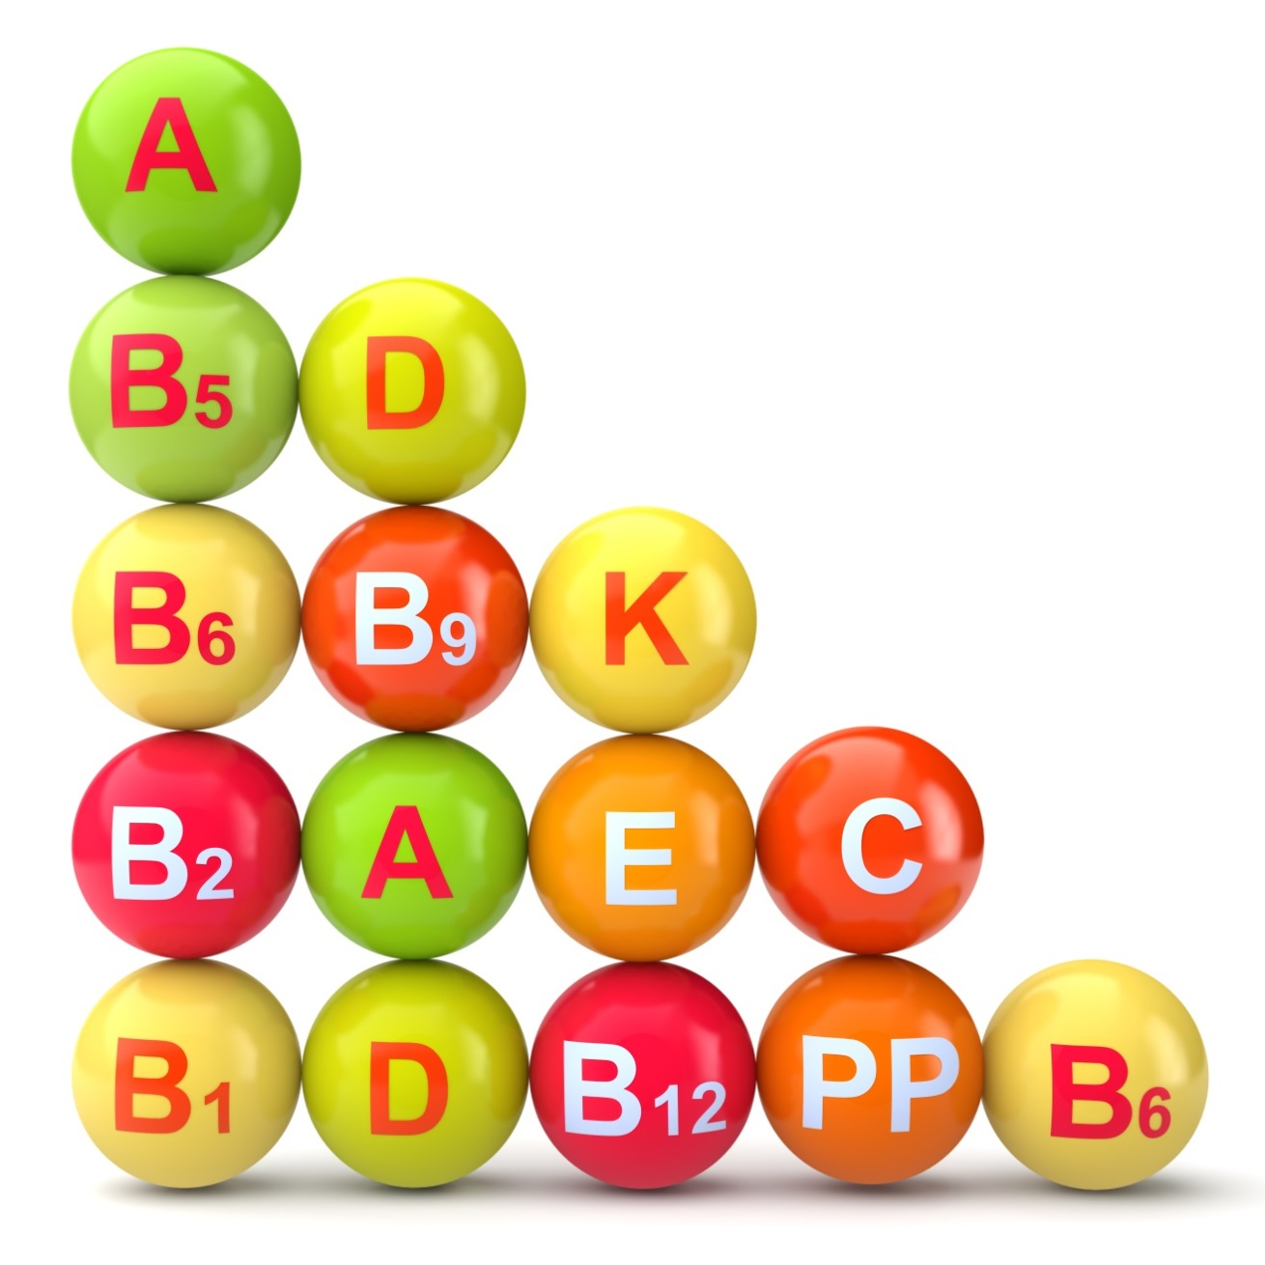
Job and Personal Resources and the Motivational Process
Autonomy in role
Performance feedback
Supervisory coaching
Peer support
Development opportunities
Value fit with the role and team
Motivational process
Ministry-Job Resources
Engagement
Vigour - Dedication - Absorption
Need to be the right “type” and quantity to match the specific work demands faced
Positive work Performance Indicators

Slide 19
Job and Personal Resources and the Motivational Process
Autonomy in role
Performance feedback
Supervisory coaching
Peer support
Development opportunities
Value fit with the role and team
Motivational process
Ministry-Job Resources
Engagement
Vigour - Dedication - Absorption
Positive work Performance Indicators
Personal Resources
Coping (effective!) style
Self-efficacy
Optimism
Extraversion
Conscientiousness

Slide 20
Job and Personal Resources and the Motivational Process
Motivational process
Ministry-Job Resources
Engagement
Vigour - Dedication - Absorption
Positive work Performance Indicators
SPIRITUAL RESOURCES
Secure Attachment to God
Collaborative religious Coping
Sense of “Call”

Slide 21
“Attachment” to God
 |  | Model of Self: Anxiety about Abandonment
 |  | + | -
Model of Other: Avoidance of Intimacy | + | Secure (Positive Other and Positive Self) | Preoccupied (Positive Other and Negative Self)
 | - | Dismissive (Negative Other and Positive Self) | Fearful (Negative Other and Negative Self)

Slide 22
Collaborative Religious Coping
Three broad styles of religious coping behaviors:
Deferral
Self Directed
Collaborative - the decision by the individual to share responsibility with God for solving the problem
WITH GOD

Slide 23
A sense of “Call”
Vague and diverse definitions in literature, yet yielding consistency in patterns of significant results.
The sense of :
“this is what I am meant to do”.

Slide 24
Health impairment process
Negative work Performance Indicators
Job Demands
Burnout
-
-
Spiritual Resources
+
+
Motivational process
Positive work Performance Indicators
Job Resources
Engagement

Slide 25
What are your relevant resources?
Ministry-Job Resources
Engagement
Vigour - Dedication - Absorption
Positive work Performance Indicators
Personal Resources

Slide 26
“..keeping you SPIRITUAL fervour..”
Higher
Job Resources
Higher
Work Engagement
Lower Spiritual Resources
Spiritual Resources
Lower
Work Engagement

Slide 27
Demands and Resources Interact
Burnout
Negative Outcomes
Job Demands
Job Resources
Engagement
Positive Outcomes
Personal Resources

Slide 28
Demands and Resources Interact
Resources | High | Average motivation but plateau in role with potential boredom. | Highly motivating and stimulating, but need to detach from work to recover energy.
 | Low | Under-stimulated in role with definite boredom – becomes “just a job” at best. | Burnout in role.
 |  | Low | High
 |  | Demands

Slide 29
Demands and Resources Interact
Resources | High | Average motivation but plateau in role with potential boredom. | Highly motivating and stimulating, but need to detach from work to recover energy.
 | Low | Under-stimulated in role with definite boredom – becomes “just a job” at best. | Burnout in role.
 |  | Low | High
 |  | Demands

Slide 30
Demands and Resources Interact
Resources | High | Average motivation but plateau in role with potential boredom. | Highly motivating and stimulating, but need to detach from work to recover energy.
 | Low | Under-stimulated in role with definite boredom – becomes “just a job” at best. | Burnout in role.
 |  | Low | High
 |  | Demands

Slide 31
Demands and Resources Interact
Resources | High | Average motivation but plateau in role with potential boredom. | Highly motivating and stimulating, but need to detach from work to recover energy.
 | Low | Under-stimulated in role with definite boredom – becomes “just a job” at best. | Burnout in role.
 |  | Low | High
 |  | Demands

Slide 32
Three essentials for promoting well-being in ministry
Identify and focus on the right job demands (i.e., challenge job demands);
Manage job demands by taking appropriate recovery to avoid chronic energy depletion; and
Constantly replenish the resources to meet those right demands – particularly spiritual resources.

Slide 33
5 Fingers for Balance
Relaxation
Exercise
Good sleep
Diet
Thinking patterns

Slide 34
Attachment to God
 |  | Model of Self: Anxiety about Abandonment
 |  | + | -
Model of Other: Avoidance of Intimacy | + | Secure (Positive Other and Positive Self) | Preoccupied (Positive Other and Negative Self)
 | - | Dismissive (Negative Other and Positive Self) | Fearful (Negative Other and Negative Self)

Slide 35
Session “take homes”
My Ministry-Work Environment
My key Ministry-Job Demands are:
My key Ministry-job Resources are:
Insights to aid in managing demands and accessing available resources:
Behaviour change I can enact to manage the stress process related to the above job demands, and draw on the job resources available:
My Personal Resources
 | Simple plan to enact | Who will I be accountable to
Key personal resources I can develop are:
Key spiritual resources to develop are:

Slide 36
Conclusion and Application
Burnout
- Exhaustion - Cynicism - Low personal accomplishment
Ministry-Job Demands
Negative work Performance Indicators
Motivational process
Ministry-Job Resources
Engagement
Vigour - Dedication - Absorption
Positive work Performance Indicators
Personal/Spiritual Resources

